Slide 1


Self Notes
Empathy

Slide 2
How to use Self Notes...
Think of this space as your personal notebook. Use it to write down your thoughts, feelings, questions and comments on topics as you go through them at your own pace.
Also use this space to compile your ‘insights and learnings’ from activities and exercises from lesson to lesson.
Self Notes: Module 1 - Empathy

Slide 3
INDEX- Empathy
S.No. | Title | Page Number
0 | Introduction – Rhythm Name Game | 5
1.0 | Lesson 1 : The What and Who | 6
1.1 | Active Listening to Know Each Other | 7
1.1 | Exercise – The Microlab | 8 - 11
1.2 | Exercise – Recall of Incidents | 12 - 13
2.0 | Lesson 2 : Why do we Empathise? | 14
2.1 | Navarasas | 15 - 16
Self Notes: Module 1 - Empathy

Slide 4
Introduction - Rhythm Name Game
Write down your feelings and thoughts after playing the game.
I had enjoyed a lot after knowing their names. And a felt calm and be very happy.Also it improves our communication skill.How each individual contributes understanding the principal of communication.Developing the trust ,respect and supportive behaviour towards each other. Developing the confidence in individual self expression , feeling comfortable being the part of the group. Focus ,listening and working as a part of the group being aware of group dynamics.
Self Notes: Module 1 - Empathy

Slide 5
INDEX
S.No. | Title | Page Number
3.0 | Lesson 3 : How do we Empathise? | 17 - 18
3.1 | Exercise – River of Life | 19 - 21
4.0 | Lesson 4 – Empathising with a Target Group | 22 - 23
4.1 | 4.1 – Intersection Café for Group Activity | 24
- | Additional Notes | 25
- | Reflections & Review | 26
Self Notes: Module 1 - Empathy

Slide 6
1.0 - Lesson 1 : The What and Where
Learn and write down the what triggers and where do you recognise your empathy
Empathy is nothing but caring about something who where in problem and difficulties. Not like sympathy it’s just When some people in problem they feel they in problem but they didn’t solve it . sharing feelings and experience a emotions ,we stimulate or represents that the same emotion in ourselves . Nowadays, you hear this word carelessly thrown around more often than necessary.In talking about empathic understanding , the meaning of sympathy and compassion is often wondered about.
I recognise my empathy :
I am student and a friend in my class has just failed a major test or exam. My friend is distraught because she studied really hard and still failed. Even though she got a good grade on this test, she remember what it is like to fail. She don't try to fix things for my friend. Instead, she make an empathetic statement like, "I'm so, so sorry about your grade. I know how hard you studied and how disappointed you must feel. "Showing empathy is an important way to build strong relationships and be a good friend. Ultimately, people feel less alone when they know you understand their perspective, and that's what empathy is all about.
Self Notes: Module 1 - Empathy

Slide 7
1.1 - Active Listening to Know Each Other
Now that you have watched the video write down your -
Insights: Listening is one of the most important skills we can have. How well we listen has a major impact on our job effectiveness, and on the quality of our relationships with others .I feel it would be of a great value in supporting parents having different conversions with their childrens .All of should be an active listener .Anyone can learn to be a good active listener. Keep eye contact ,be patience, and understand the emotions behind the words.
Learnings: I learnt how to be a good listener and to be good active.We don’t to hesitate when it come to listening.
To enhance our listening skills, we need to let the other person know that we are listening to what they're saying.
Self Notes: Module 1 - Empathy

Slide 8
1.2 - Exercise – The Microlab
Write down how you felt when others shared their moments with you.
“Moment of Happiness”
How did that person feel? How would you have felt in the same situation?
I think she feels happy and has to no words to talk with all of them presence.As she is in excitement at how her parents be feels. That is the unforgettable moment in her life.
2. What did they say about it? What do you think they didn’t say about it?
She feel happy and told if some moment is happy i forgot the world at that moment.
Self Notes: Module 1 - Empathy

Slide 9
1.2 - Exercise – The Microlab (2)
“Moment of sadness”
How did that person feel? How would you have felt in the same situation?
I think she feel bad and she is crying in front of me and she shares every moment with me and blame herself how it is possible to happen?
What did they say about it? What do you think they didn’t say about it?
As she feels bad and she says what happened in my life god given so many difficulties in my life.
Self Notes: Module 1 - Empathy

Slide 10
1.2 - Exercise – The Microlab (3)
“Role Model”
Why do you think that person chose that role model?
Abdul kalam is the role model of her life because as his famous thought among all one of is BLACK COLOUR IS SENTIMENTALLY BAD.BUT EVERY BLACK BOARD MAKES THE STUDENT BRIGHT .because every person has one unique character.
2. How did you feel when you shared your experiences?
I feel very calm by sharing my experience with my friends.
Self Notes: Module 1 - Empathy

Slide 11
1.2 - Exercise – The Microlab (4)
Now write about your personal experience -
A happy memory : I feel happy when i meet my old friends after a long time in a beach.We all share all our experience with my old friends.Really it just amazing that i feel to be an one my enjoyable moment in my life .We all shared our feelings and emotions that we felt.
2. Moment of sadness : When i got 10th marks less than i expected i feel so bad. I am really sad because when i got grades then i am not going to get very far. I am being driven by a need to satisfy my parents and teachers not really learn the subject. I admit I have been guilty of this too, but it has taken me some time to realize that once I start learning the subject for myself and for my reasons the grades will come, and if at first they don't it won’t matter as much.
3. Role Model: Swami vivekananda:”Everything is easy when you are busy,but nothing is easier when you are lazy”.
Self Notes: Module 1 - Empathy

Slide 12
1.3 - Exercise : Recall of Incidents
Write down your observations and feelings on about 3 to 4 situations you recall -
Situations 1 -When i went to my college i see there is person who is completely handicap so feel so bad at that time. I Feel to be so sad.
Situation 2 - One upon a time when i was a child i am went to the tour which conducted in my school it is nearer to my town .
We really enjoyed with my friends and teachers.
Self Notes: Module 1 - Empathy

Slide 13
1.3 - Exercise 2 : Recall of Incidents (2)
Write down your observations and feelings on about 3 to 4 situations you recall -
Situations 3 - I was in UKG I went go to my fathers office alone . And It’s too difficult for me to go there in my childhood.
It’s my luck that there were no vehicles at that time . Now I am feeling to be fear. And my father had told me not to do like that. My teacher also become panic.
Situation 4 - When I met my friends in the park. I really doesn’t know who is she? When i meet her at the first time,We really doesn’t know how she is came in my life. Just we meet in the park, now we becomes a close friends.
Self Notes: Module 1 - Empathy

Slide 14
2.0 - Lesson 2 : Why do we Empathise?
List down your answers for the following questions
1. Why did Teja panic? What did she do when she noticed the truck? Why do you think she did so?
Teja becomes panic when she notice truck is coming nearer to her.she becomes panic.
2. What would have happened to Balu if the truck hadn’t come to a stop?
If truck is hasn’t come to stop he become died.
3. Balu did not feel anything when the truck was speeding towards them. Did the lack of emotion help him in any way to be safe and not be run over by the truck?
Balu didn’t feel anything when the truck was speeding towards them. Lack of emotions & confidence helps in any way to be a safe it effects on physical and emotional health.
Self Notes: Module 1 - Empathy

Slide 15
2.1 - Exercise 1 : Navarasas
Now that you have watched the video on Navarasa.
Question 1 - Write down the various emotions you felt. Which of these emotions were easy and which were difficult
I felt anger,anxiety,sad,surprise,happy,disgust,fear
easy -happy, anger, disgust
Difficulty-anxiety, fear, sad ,surprise
Self Notes: Module 1 - Empathy

Slide 16
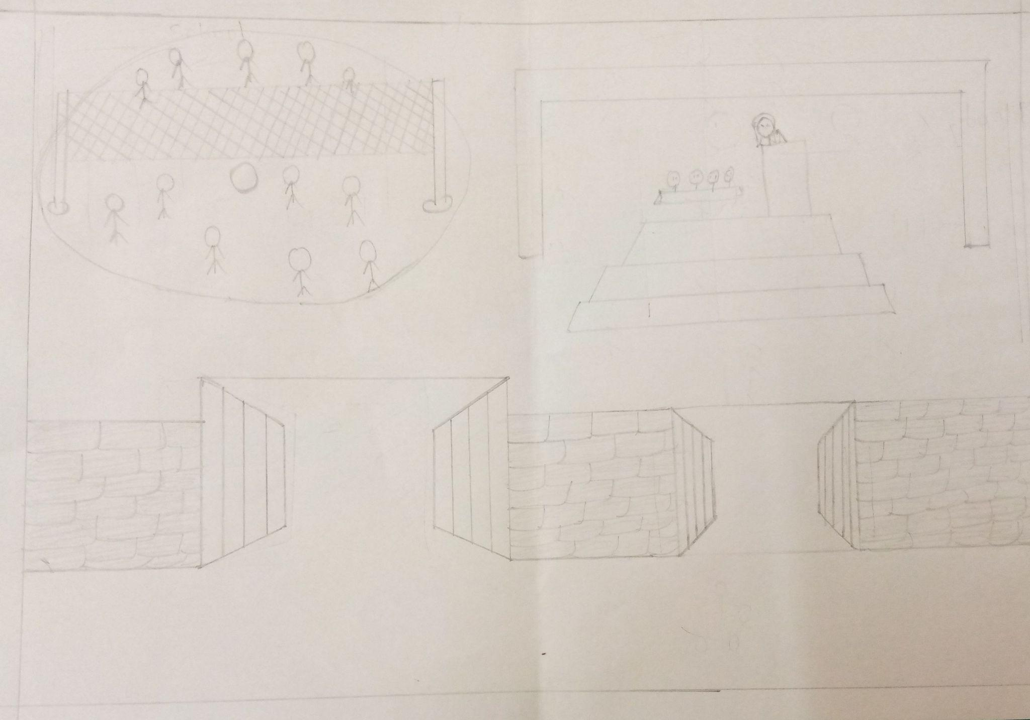
2.1 - Exercise 1 : Navarasas (2)
Question 2 - Draw your body outline and express if you recall where did you also get body reactions. (for example while feeling sad, your face muscles are pulled in or while feeling anger, your body is taut).
Self Notes: Module 1 - Empathy

Slide 17
3.0 - Lesson 3 : How do we Empathise? Part 1
Write your observations from the comic strips.
Question 1 - Why did she walk away in the middle of the conversation?
Because balu didn’t understand her feelings & emotions and he was busy in watching mobile.
Question 2 - What could Teja have done instead, to be heard?
Teja has to tell to balu to not using phones.
Question 3 - What could Balu have done to keep Teja from walking away?
Simply balu is doing his work and he is not worried about her feelings. He was just using his mobile phones.
Self Notes: Module 1 - Empathy

Slide 18
3.0 - Lesson 3 : How do we Empathise? Part 1 (2)
To gain some additional points, write & submit your views to the faculty on this topic
In order to make a meaningful conversation, with people at the 1st we have to keep eye contact with each person and we have to stop engaging our own thoughts.making an individual attention that means we have to keep all other activities at the side when someone is doing conversation . along with that we have to show curiosity and care while talking with that person.and asking the questions in the middle of the conversation.and allowing the persons to listen more.
Self Notes: Module 1 - Empathy

Slide 19
3.1 - Exercise 1 : River of Life (1)
You watched the video on the activity “River of Life”. From the activity, share your experience on the following aspects:
1. Which particular chart made you think, “Oh, I would have not seen it in that angle like that person did”?
I had not seen ever that a person,how is amazing in doing his work .
2. Which chat made you think, “I wish I got to experience that too”?
I want to my childhood be return,so that i will play all that games and enjoy and experience that event again.like i playing throw ball in the spring time there is an amazing playground at that time . I will never forgot it as well.
Self Notes: Module 1 - Empathy

Slide 20
3.1 - Exercise 1 : River of Life (2)
3. How did this entire activity of seeing each other’s river of life aﬀect you? What do you think and feel about it? Why do you think you were asked to do it?
By knowing and sharing our all experience ,some events we all are discuss in my group that all enjoyed more.We start asking questions
Among ourselves what happened at that day,how do u express that feelings and so on questions will ask to each other and all of them told that day will never come again.It is the precious day in their life .
Self Notes: Module 1 - Empathy

Slide 21
3.1 - Exercise 1 : River of Life (3)
You watched the video on the activity “River of Life”. From the activity, share your experience on the following aspects:
- Diﬀerent perspectives/angles-By seeing at different angles I think that i recall my memories in my childhood times. I it refresh our mind.
- Experiences that I missed -I miss one precious moment that i will never forgot that in my life that is my precious day of my school when i didn’t go the school there is an annual problem conducted.I am not well at that day.
- What evoked and stirred your mind as you listened and shared?
I think we all enjoyed by sharing our experience in that moment and by giving some time . And I want to feel all that events that they feel in their life.
Self Notes: Module 1 - Empathy

Slide 22
4.0 - Lesson 4 : Empathising with the Target Group
Write down your learnings from the comic strip -
1. Why do you think Balu and Teja are hesitating to interact with the senior citizens?
Because they didn’t know how to interact with senior citizens. And they were thinking that if they become angry with their words.
2. What would you do if you had to interview senior citizens in an old age home to understand their way of living?
Our parents are the most familiar people in the world, but sometimes they can be the most mysterious as well. If I am in a interview with senior citizens, I will ask the following questions,
1)what is your name? And where you were born?
2)How many members do you have in your family??
3)Can you state the reasons for which you are living in an old age home?
4)Would you say you have made a new of your own family?e?
5)How do you feel about living in an old age home?
. I
Self Notes: Module 1 - Empathy

Slide 23
4.0 - Lesson 4 : Empathising with the Target Group(2)
Write down the insights and learnings from the comic strip -
INSIGHTS: I think we have to interact and communicate with those people who were living there.And leading their life in that situations.This was a beautiful piece of writing that should remind all of us that senior citizens need to feel wanted and should always be treated with dignity.
Learnings: I learnt to be kind and humble.“We should listen to our elders, not because they are always right, but because they have more experience in being wrong.” learn from older adults is to stick to our priorities.
Lea
Self Notes: Module 1 - Empathy

Slide 24
4.1 - Exercise 1 : Intersection Café for Group Activity
After completing the Intersection Café for Group Activity, write down your feelings/ observations.
Intersection cafe is nothing but the place where we have to go with our team together to discuss on their projects.It is
one of such a place where all meet and make conversation among themselves to know more about them.and shares
their emotions,problems, feelings. It is a space where all diversity is welcome for sharing of questions, thoughts
that converge to ideas in a creative and constructive manner. It is a movement of divergence to convergence .And
by sharing their feelings they may feel good.
Self Notes: Module 1 - Empathy

Slide 25
5.0 - Additional Notes
Pen down or write down your insights/takeaways on the Empathy Module , the importance and the changes that you may have experienced.
Empathy is one of the most important aspects of creating strong relationships, reducing stress, and enhancing emotional awareness. But there are so many benefits to empathy that most people aren’t even aware of. For example, I also notice that when I feel empathy for others and for myself, I feel a sense of peace, connection, and perspective that I like. And, when there is an absence of empathy in a particular relationship, situation, or in how I’m relating to myself, I often experience stress, disconnection, and negativity.It implies feeling with a person, rather than feeling sorry for a person. It helps us better understand how others are feeling, and even feel it in ourselves. It helps us maintain relationships and plays a role in dictating our success in both personal and professional relationships.
Self Notes: Module 1 - Empathy

Slide 26
Reflections & Review
Great Work.. Add your quick reflections and module review and now you move to the Define Module
It reflects on our personal emotions and also improved our capacity of understanding the situation to a great extent by sharing the feelings.
Self Notes: Module 1 - Empathy

Slide 27

Self Notes
Define

Slide 28
INDEX - Define
S.No. | Title | Page Number
- | Introduction to Define | 30
- | Glimpse of learning outcome & Exercise | 31 – 32
1.0 | Lesson 1 : The What and Who | 33 - 35
2.0 | Lesson 2 : Stakeholder Persona Examples | 36
2.1 | Case Study | 37
2.2 | Taking Students Back to School | 38 - 43
Self Notes: Module 2 - Define

Slide 29
INDEX - Define
S.No. | Title | Page Number
3.0 | Defining the Problem or Opportunity Statement | 44
4.0 | POV Statement - The What | 45
4.1 | Problem Statement | 46 - 47
4.2 | More Exercises | 48
4.3 | POV Statement Checklist | 49
4.4 | Assessment | 50
5.0 | Additional Notes | 51
Self Notes: Module 2 - Define

Slide 30
Introduction to Define
What are insights on the Introduction ? Write your notes
Define module tells us about stakeholder personas along with pain point and needs .
Synthesize in order to define problems.
Self Notes: Module 2 - Define

Slide 31
A Quick Glimpse of Learning Outcome
Write your Understandings and Learnings and share it with your faculty.
We have to develop positive relationship with the community.
Re -framing and problem in human centris ways.Great ideas to establish features, any other elements that will allow
them to solve themselves with the minimum of difficulty.
.
Self Notes: Module 2 - Define

Slide 32
Exercise - Vidya Says
Write your Understandings and Learnings and share it with your faculty.
How to re - emphasize the act of learnings. What does the user is saying about that
and what doesn’t?
We have to define social innovations as new ideas that simultaneously meet social needs and creating
the new relationships and collaborations.
Learnings:
I learnt what to do to infuse an approach to innovation that is powerful, effective and broadly accessible
understanding of the fundamental phases and methods in design thinking, and we have to learn how the
implement our new found knowledge in our life.
Self Notes: Module 2 - Define

Slide 33
1.0 - Lesson 1 – Defining the Problem – The What and Who
Write your Understandings and Learnings
1. What do you think is the problem?
The leaves were spreading and also the water in the pathways. And it is difficult to walk on the roads.And also it
difficult for old people to walk and also feel to be bad and uncomfortable by walking.
2. Who gets affected by the problem?
It is the problem that will face by all the peoples who were walking in roads, and also people who are aged ones will
can fall in that pathways. And at the same location there is the school in that place so the child will play in that
area so they are also affected in that problem.
Self Notes: Module 2 - Define

Slide 34
1.0 - Lesson 1 – Defining the Problem – The What and Who(2)
Write your Understandings and Learnings
3. Who should take up the issue?
Government and ministry of road transport and highways. Should take the issues of local people.
And understand the problems of the they were facing every day.
Government will take steps to ensure that safety features.
Some effective measures of road safety are like basic awareness about vehicle, defensive driving according to weather and road conditions.
4. Why do you think Balu and Teja asked for clarifications?
The listener is making the the speaker elaborate on their thoughts and providing a more detailed version of them.
This not only helps the listener better understand what the speaker meant but also helps them form an opinion of their own regarding the speaker's views.
Self Notes: Module 2 - Define

Slide 35
1.0 - Lesson 1 – Defining the Problem – The What and Who(3)
Write your Understandings and Learnings
5. Where is the problem happening?
The problem is happening in the paths that every day the peoples will walk on that path there is the chances of falling
down. Peoples may get injured during walking .especially the old age peoples, who cannot see the the paths clearly.At
That time they suffer several problems.
Self Notes: Module 2 - Define

Slide 36
2.0 - Lesson 2 : The Stakeholder Persona Examples
Write your Understandings and Learnings.
I often help our clients develop personas for the audiences they plan to target with their communications.
Know who they are in the first place.
Identify where they are, inside your organization or outside of it.
Determine what they need from you and what you need from them to move your work forward.
learnings:
personas share common characteristics, such as demographics, training goals, professional responsibilities, educational
background, skill level and preferred platforms.
Self Notes: Module 2 - Define

Slide 37
2.1 - Exercise : Case Study
Write your Understandings and Learnings.
Understandings: How the peoples lead their life in the villages. Lack of supports from their parents.
And most of the classrooms are empty in the villages. Because of adequate facilities in the schools.
In villages most of the parents are farmers they don’t take care of their childrens.Who were busy in their occupations.
Unable to communicate in the same languages, making them ignorant and isolated.
Learnings: Some of the childrens want to learn something new but the lack of support by them.
Parents force them to go outsides to do some work and involving in some household chores.
As they don’t have the enough money.
Self Notes: Module 2 - Define

Slide 38
2.2 - Exercise : Case Study
Create two Stakeholder Persona with these details (Persona 1)
Picture of Persona/ image: Name – Real or Fictitious: Housewife Vasundara. Demographics – Age, Gender, and Family: Age = 35
Gender :Female
Family: Working husband with 6 year old girl and 10 year old boy-school going.
Self Notes: Module 2 - Define

Slide 39
2.2 - Exercise : Case Study(2)
Create two Stakeholder Persona with these details (Persona 1)
Pain points : She has to get up early to collect water.
Sometimes water does not come and must go somewhere else to collect.
In view of water scarcity at times the family do not have proper bath.
Drinking water is also limited.
Vessels have to be wiped clean rather than washed properly at times.
Gains/ Needs :Needs a predictable water supply.
Per day need about 500 liters.
Water should come with enough pressure so that less time to store it or fill up the sump.
I would like to earn it three is time from water issues.
I would lie to have some indoor plants.
Self Notes: Module 2 - Define

Slide 40
2.2 - Exercise : Case Study(3)
Create two Stakeholder Persona with these details (Persona 1) Traits:
Can use of smartphones.
Can teach the school childrens.
Skills:
Know use of internet.
Is a talented gardener.
Self Notes: Module 2 - Define

Slide 41
2.2 - Exercise : Case Study(4)
Create two Stakeholder Persona with these details (Persona 2)
Picture of Persona/ image:
Name – Real or Fictitious: carefree Ramu. Demographics – Age, Gender, and Family:Age :45
Gender:Male
Family:Is married with 12 year and 7 year girl going school. His mother stays with him,who needs care.
Self Notes: Module 2 - Define

Slide 42
2.2 - Exercise : Case Study(5)
Create two Stakeholder Persona with these details (Persona 2)
Pain points:
Knows the problem and feels helpless as there is a resource crunch
Does not have a trained work men and at times no one is present.
His superior is not very sympathetic.
Gains/ Needs:
I am tired of water complaints and would like to have the peaceful days.
If only I had resources , then in few weeks I can resolve the issue.
Wish I had the courage to speak to my superior and get resource .
Self Notes: Module 2 - Define

Slide 43
2.2 - Exercise : Case Study(6)
Create two Stakeholder Persona with these details (Persona 2) Traits:
Knows how to execute the water pumping systems.
Is computer savvy.
Skills:
When pushed is active.
Is an amateur singer.
Self Notes: Module 2 - Define

Slide 44
3 - Defining the Problem or Opportunity Statement
Write answers for mentioned questions for better Insights.
What was the original mission statement?
Detailed images of moon’s surface.
What was the new statement?
earthrise.
Why did it change?
Reframing the statement helps us to get a clear idea.
Self Notes: Module 2 - Define

Slide 45
4.0 – Lesson 4 : POV Statement – The What
Write answers for mentioned questions for better Insights.
The POV is a framework that allows you to ideate and solve your problem in a goal-oriented manner. It
Involves reframing a social challenge into a meaningful and actionable problem statement.
It consists of uses ,deep ,insights.
Users : who are the primary and secondary users .
Deep : It involves the both pain points and goals.
Insights :What we have learnt from that.
Self Notes: Module 2 - Define

Slide 46
4.1 – Exercise : Problem Statement
Write reframed POV statement based on questions given given in 4.1 exercise: Who are the users ? Students who are not able to go to school .
Parents who are not able to send their children to school.
Why do they play online games ?
Passing time,
Entertainment,
Challenge,
fantasy/role playing,
social interaction.
How much time do they spend ?
As they spend more times in playing online games.
On average they spend time on this daily leisure activity.
Self Notes: Module 2 - Define

Slide 47
4.1 – Exercise : Problem Statement(2)
Write reframed POV statement based on questions given given in 4.1 exercise: What is their need ?
Online games are important to understand because they offer a huge amount of fun , teamwork , enjoyment, collaboration and imaginative adventure for children. Played healthily they contribute an essential part of children's development and socialisation. Where do they play these games ? (mobile, tab, cellphone)
As they play games in mobile or tabs and in laptops. What could be alternatives ?
art, dance, or music lessons.
Nature activities such as whitewater rafting or hiking.
Martial arts.
Learning to code.
Internships at startups.
Competitive Sports.
Self Notes: Module 2 - Define

Slide 48
4.2 – Lesson 4 : More Exercises
Create at-least two POV statements for given Scenarios-
1)“To provide basic facilities to the “Anganwadi” school students such as power supply, an attractive classroom for better study environment”
1)users:Students,parents
2)need of users:
To enjoy friendship
Easy way to send their children to school
3)Insights: Ventilation and Air Quality
Lighting
Temperature control
Space and size of classrooms
2)“Designing a water storage system for a community”
1)users:municipal
2)need of users:Storage of Water in Buildings-Storage tanks are an integral part of an Indirect Water Supply System. Storage of water in premises is required.
3)insights: provide services.
Self Notes: Module 2 - Define

Slide 49
4.3 – Lesson 4 : POV Statement – The Checklist
Head to the Intersection Café and create the POV statement for your Social Challenge project -
Our POV statement : Improvisation in learning techniques of def and dum childrens through graphic communication and tactile symbols.
Self Notes: Module 2 - Define

Slide 50
Assessment
Write your notes
During the Define stage, we put together the information we have created and gathered during
the Empathise stage. This is where we will analyze our observations and synthesize them in
order to define the core problems that i and our team have identified up to this point. We
should seek to define the problem as a problem statement in a human-centered manner.
To illustrate, instead of defining the problem as your own wish or a need of the company .The Define stage will
help the designers in your team gather great ideas to establish features,
functions, and any other elements that will allow them to solve the problems or, at the very
least, allow users to resolve issues themselves with the minimum of difficulty.
Self Notes: Module 2 - Define

Slide 51
Reflections & Review
Great Work.. Add your quick reflections and module review and now you move to the Ideate Module
It reflects on our personal emotions and also improved our capacity of understanding the situation to a great extent by sharing the feelings help the designers to team gather great ideas to establish features ,functions and any other elements that will allow them to solve the problems.
Self Notes: Module 2 - Define

Slide 52
Self Notes
Ideate

Slide 53
INDEX- Ideate
S.No. | Title | Page Number
0 | Introduction to Ideate | 56
1.1 | Lesson 1 : The System Perspective | 57
1.2 | Lesson 1 : The systems perspective - Cause and Effect | 58 - 60
1.3 | Lesson 1 : The systems perspective - Input, Process and Output | 61 - 63
1.4 | Lesson 1 : The systems perspective - Past, Present and Future | 64 - 66
1.5 | Lesson 1: The Case Study | 67
1.6 | Intersection Cafe - Apply System Perspective to your Social Challenge | 68
Self Notes: Module 3 - Ideate

Slide 54
INDEX - Ideate
S.No. | Title | Page Number
2.0 | Lesson 2 : Brainstorming | 69
2.1 | Lesson 2 : Brainstorming - Video & Its Rules | 70
2.2 | Lesson 2 : Expanding the power | 71
2.3 | Lesson 2 : SCAMPER Technique | 72
2.5 | Intersection Cafe : Idea Generation To Your Social Challenge | 73
Self Notes: Module 3 - Ideate

Slide 55
INDEX - Ideate
S.No. | Title | Page Number
3.1 | Lesson 3 : Idea Evaluation - Approach 1 | 74
3.2 | Lesson 3 : Idea Evaluation - Approach 2 | 75
- | Assessment | 76
- | Additional Notes | 77
- | Reflections & Review | 78
Self Notes: Module 3 - Ideate

Slide 56
Introduction to Ideate
Write your Understandings & Learnings
It is the process where we generate ideas and solution through focus on users and their needs.
It is the act of forming ideas.To move ideas from conception to implementation.
It helps to ask the right questions and innovate.
Step beyond the obvious solutions and therefore increase the innovation potential of our solutions.
Self Notes: Module 3 - Ideate

Slide 57
1.1 – Lesson 1 : The System Perspective
Write your Understandings & Learnings
The systems perspective is a theory that describes studying how a system works as a whole within its environment.
A detailed way of getting a system perspective is to break it down it in
Terms of,cause,effect,input-process-output,past-present-future,as variation / deviation in each elements,
or future outlook can trigger innovative ideas to create new opportunities.
Examines organizations learnings from a regulator perspective and claims the need for a system perspective to learnings.
Self Notes: Module 3 - Ideate

Slide 58
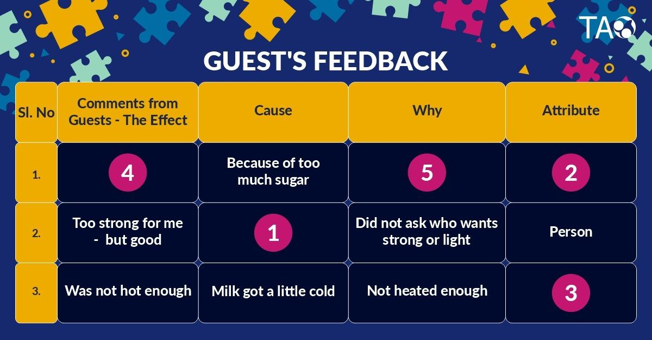
1.2 – Lesson 1 : The System Perspective – Cause and Effect
Think & Fill Activity
Self Notes: Module 3 - Ideate

Slide 59
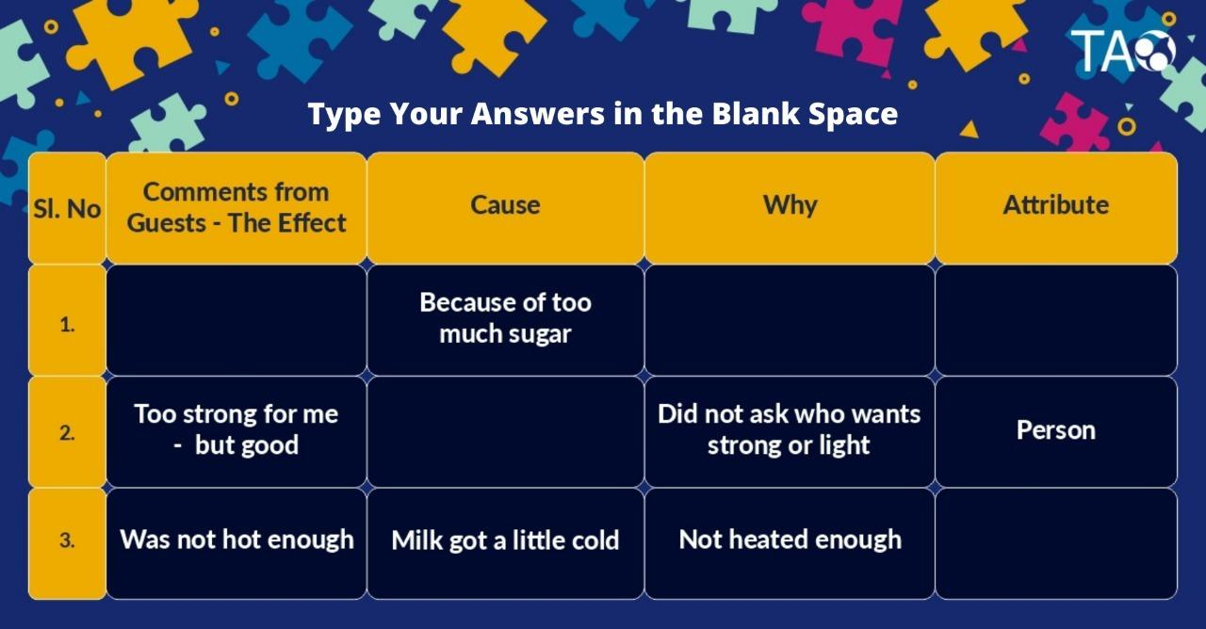
1.2 – Lesson 1 : The System Perspective – Cause and Effect
Options : Person, Method, Same Tea for Everyone, Tea is too sweet, Did not check with the guest how much to add
Tmplate to be added
Tea is too sweet
Same tea for everyone
person
Did not check with guests how much to add
method
Self Notes: Module 3 - Ideate

Slide 60
1.2 – Lesson 1 : The System Perspective – Cause and Effect
Write your Understandings and Learnings.
The ishikawa diagram developed by professor kaoru ishikawa helps us to understand the cause and effect of
Relationship in order to find out what could be the reasons that if not done as per standards.it gives us a holistic
view and understanding that even if one element is absent the activity cannot be completed if there any issues
problems , systems as designed is not effective.
Self Notes: Module 3 - Ideate

Slide 61
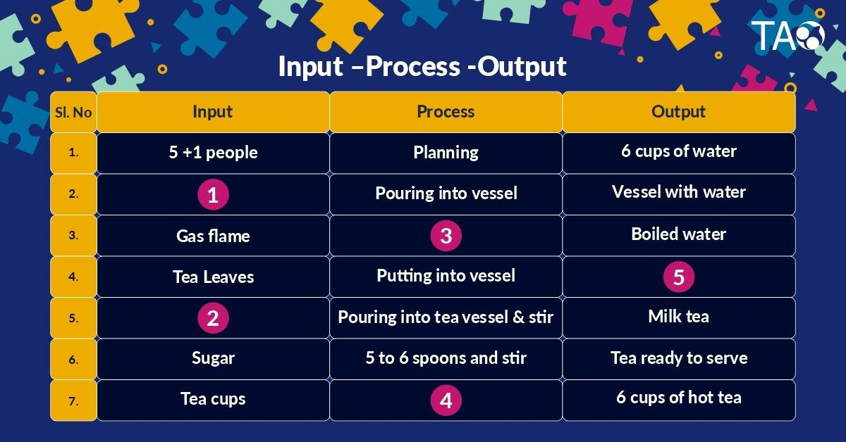
1.3 -Lesson 1 : The systems perspective - Input, Process and Output
Think & Fill Activity
Self Notes: Module 3 - Ideate

Slide 62
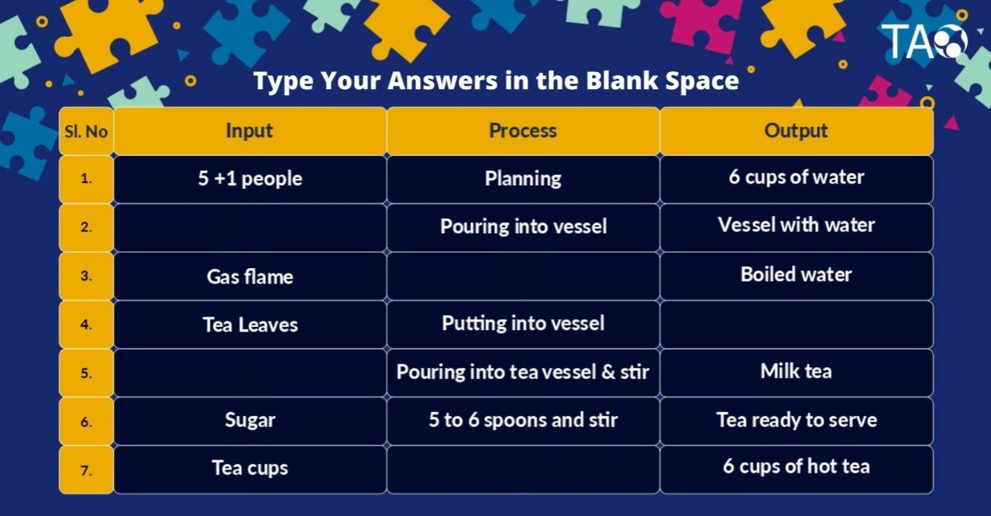
1.3 -Lesson 1 : The systems perspective - Input, Process and Output
Options : Brewed tea decoction, Heating, Pouring tea into cups, Water and Vessel, Hot Milk
Water and vessel
heating
Brewed tea decoction
Hot milk
Pouring tea into cups
Self Notes: Module 3 - Ideate

Slide 63
1.3 -Lesson 1 : The systems perspective - Input, Process and Output
Write your Understandings and Learnings.
A process is defined as a sequence of activities that convert inputs into a desired output.so , a process can start
when the right inputs are given that triggers an activity to deliver an output.
It helps in understanding the process in a right manner. Many a time if the inputs are not correct, the process will
go wrong leading to an incorrect output or even the process may not start.
Self Notes: Module 3 - Ideate

Slide 64
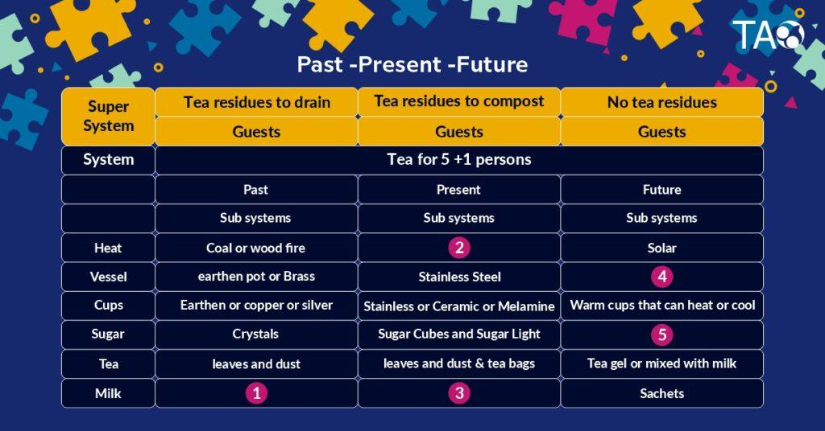
1.4 Lesson 1 : The systems perspective - Past, Present and Future
Think & Fill Activity
Self Notes: Module 3 - Ideate

Slide 65
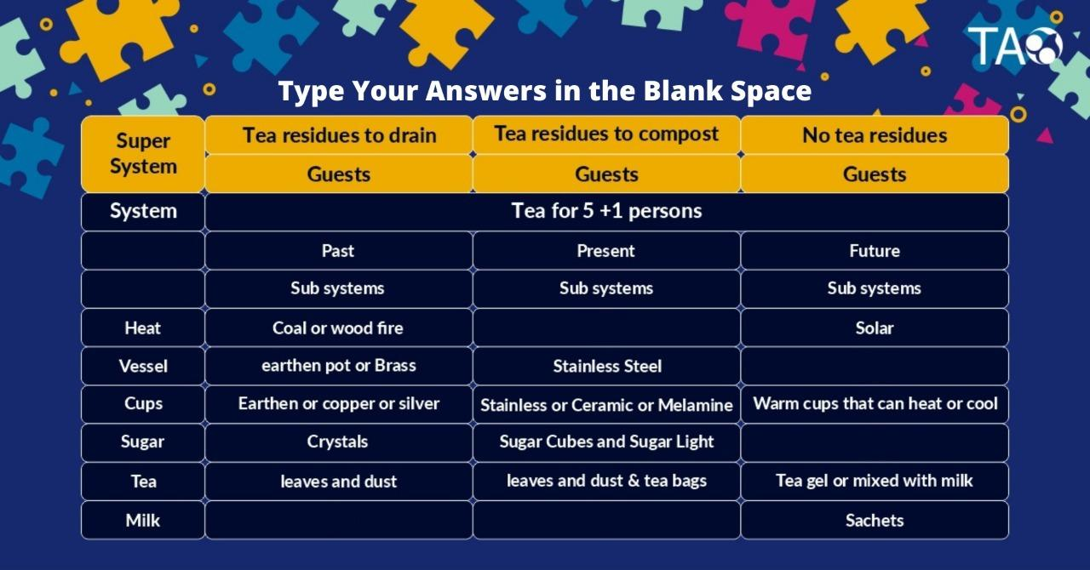
1.4 Lesson 1 : The systems perspective - Past, Present and Future
Options : with sugar gel or cubes, Bottled, Fresh, Gas Stove, Composites
Gas stove
composites
With sugar gel or cubes
botteled
fresh
Self Notes: Module 3 - Ideate

Slide 66
1.4 Lesson 1 : The systems perspective - Past, Present and Future
Write your Understandings and Learnings.
In this we can understand that the importance of past , present and future of our social challenge.This will helps to
discuss about the past,present and future.
In this we can see one examples of tea in which we discuss about how it is there in past that is they must use
the coal and wood , earthen pots and brass, crystals and leaves and dust.but in present we are using gas stove .
Stainless steel,sugar cubes. But in future we will use solar, composites and sachets.
Self Notes: Module 3 - Ideate

Slide 67
1.5 Lesson 1: The Case Study
Write your Understandings and Learnings.
In this we can understand the system perspective in that cause and effect of the given problem.
We are not considering controls and resources . past-present-future can be understandable in during this study.
The change in technology and continually changing.
In this lesson we learn how going to school is affected its cause and solution. we can correlate this lesson to our social
problem, which helps us to generate ideas. We also learned how schooling is changed from our past to present, and by which
we were able to predict the future .
Self Notes: Module 3 - Ideate

Slide 68
Intersection Cafe : The Systems Perspective – Apply Systems Perspective To Your Social Challenge
Write your Understandings and Learnings.
In our social challenge the systems perspective taken is:
System we have taken is priyadarshini deaf anddeam school.
Sub system is teachers.
Super system is students.
Self Notes: Module 3 - Ideate

Slide 69
2.0 - Lesson 2 : Brainstorming
Write your Insights & Learnings on Brainstorming from Sketches
Why did the professor say “let’s brainstorm” ?
To generate large quantity of ideas
Why did they go outside? Easy generation of ideas can be done by observations.
What do you think is brainstorming? Brainstorming is generation of large quantity of ideas irrespective to its to working but should be related to the problem
Who are in the picture along with Balu & Teja? (gardener, sweeper)
(gardener, sweeper) Stakeholders, sub system
Self Notes: Module 3 - Ideate

Slide 70
2.1 – Lesson 2 : Brainstorming – Video & Its Rules
Write your Insights & Learnings on Idea generation using Brainstorming technique
A brainstorm session involves sprouting related points from a central idea. Brainstorming is one of the primary
methods employed during the ideation stage of a typical design thinking process.
Brainstorming is a great way to generate many ideas by collective thinking of the group,engaging with each other,
listening,and building on ideas.
It involves focusing on one problem or challenge at a time, while build on each other’s response and
ideas with the aim of generating as many potential solutions as possible.
Self Notes: Module 3 - Ideate

Slide 71
2.2 - Lesson 2 : Expanding the Power
Write your Understandings & Learnings from above video
In this topic we get to know the power of 10. we take the number 10 as a circle which in the beginning is the size of a meter long loop, as we increases the power of 10 the circle gets bigger, so big that at the highest power the entire galaxy ic covered within the circle. This explains the power of 10
Self Notes: Module 3 - Ideate

Slide 72
2.3 - Lesson 2 : SCAMPER Technique
Write your Understandings & Learnings from SCAMPER technique :
Creative thinking and problem-solving are essential parts of the learning process to turn ideas into innovation to create
creativity.A successful method used in creative thinking is the Scamper technique.
The SCAMPER technique is a team brainstorming technique used to develop or improve products or services.
SCAMPER an acronym for substitutem,combine,adapt,modify,purpose,eliminate,rearrange.
Creating thinking and problem solving are widely considered abilities that can be learned, taught, and implemented
Contributing to develop innovative strategies , which can be applied in order to enhance the teaching-learning process .
Self Notes: Module 3 - Ideate

Slide 73
Intersection Cafe : Idea Generation To Your Social Challenge
Write your Understandings & Learnings from SCAMPER technique :
The idea we have have generated is to enhance to the communication through
1. Graphic communication.
2. Tactile symbols.
3. Assistive listening device
Self Notes: Module 3 - Ideate

Slide 74
3.1 - Lesson 3 : Idea Evaluation - Approach 1
Write your Understandings & Learnings from Idea evaluation technique
After generation of large quantities of ideas, evaluation of such idea must be done in order to have a effective and working
idea based on the resource available such as time, money, source, sponsor and other impact
Self Notes: Module 3 - Ideate

Slide 75
3.1 - Lesson 3 : Idea Evaluation - Approach 2
Write your Understandings & Learnings from Idea evaluation technique
Another way of identifying the right idea among the list is taught in this lesson. A good ide can be selected by notion down it impact, and benefits caused To assess the ease of implementation, the team should consider the cost of the idea, along with any behavior change required, time taken and resources available to implement the idea.
Self Notes: Module 3 - Ideate

Slide 76
Assessment
Brainstorming help us get vast ideas for solving our social problem.this method involves focussing on
one challenge at a time, while team members build on each other’s response and ideas with the aim
Of generating as many potential solutions as possible .
These can then be refined and borrowed down to best solutions.participants must then select the
best,the most practical,or the most innovative ideas from options come up with.
Self Notes: Module 3 - Ideate

Slide 77
Extra Notes
brainstorming is a creative activity,each member should try to encourage other member and create an
environment in which they feel comfortable verbalising their ideas .
Free thinking may produce some ideas that are wide off mark,but brainstorming is about drawing up as many
Ideas as possible which are then whittled down until the best possible options remains.
Self Notes: Module 3 - Ideate

Slide 78
Reflections & Review
Great Work.. Add your quick reflections and module review and now you move to the Prototype Module
This module helped us how to generate ,list down the ideas and to evaluate and select a appropriate idea which is suitable and acts effectively to the problem
It reflects to be a better able to communication ideas be more creative in identifying opportunities.Have an improved capacity for analysis and synthesis.
Self Notes: Module 3 - Ideate

Slide 79

Self Notes
Prototype

Slide 80
INDEX- Prototype
S.No. | Title | Page Number
- | Introduction to Prototype | 81
1.1 | Lesson 1.1 : Observe, Design and Create | 82
1.2 | Lesson 1.2 : Creating the Specifications - The Plan-Do-Cycle & Case study | 83 - 84
2.0 | Lesson 2 : User Centric Approach | 85
3.0 | Lesson 3.0 : Building the Prototype - Mirror Game | 86
3.1 | Lesson 3.1 - Prototype Building | 87 - 89
4.0 | Assessment | 66
Self Notes: Module 4 - Prototype

Slide 81
Introduction to Prototype
Write your learnings & Understandings
Self Notes: Module 4 - Prototype

Slide 82
1. Lesson 1.1 - Observe, Design and Create
Write your Insights & Learnings from Slide 1 to Slide 8 and share it with your faculty and head to to Intersection Cafe and perform this activity with your group
Self Notes: Module 4 - Prototype

Slide 83
1.2 -Lesson 1 : Creating the Specifications
Write your Understandings & Learnings from the comic strips Why are Balu and Teja a little worried? What do you understand from the phrase “from what to how”? How does the Professor address the action or the doing part? Who volunteers to do it and why?
Self Notes: Module 4 - Prototype

Slide 84
1.3 Lesson 1 - The Case Study
Write your Understandings & Learnings from the above topic and head to Intersection Cafe for the group work to list down the Action Points:
Self Notes: Module 4 - Prototype

Slide 85
2.0 Lesson 2 - User Centric Approach
Write your Understandings & Learnings on User Centric Approach
Self Notes: Module 4 - Prototype

Slide 86
3 Lesson 3 - Building the Prototype - Mirror Game
Write your Understandings & Learnings from Mirror Game:
Self Notes: Module 4 - Prototype

Slide 87
3 Lesson 3 - Prototype Building Part 1
Write your Understandings & Learnings from the Prototype Building
Self Notes: Module 4 - Prototype

Slide 88
3 Lesson 3 - Prototype Building Part 1 (2)
Write your Understandings & Learnings from the Prototype Building
Self Notes: Module 4 - Prototype

Slide 89
3 Lesson 3 - Prototype Building Part 2
Write your Understandings & Learnings from the Prototype Building and head to Intersection Cafe to build prototype and simple action plan
Self Notes: Module 4 - Prototype

Slide 90
Assessment
Write your Understandings & Learnings
Self Notes: Module 4 - Prototype

Slide 91
Reflections & Review
Great Work.. Add your quick reflections and module review and now you move to the Prototype Module
Self Notes: Module 4 - Prototype

Slide 92
Self Notes
Test

Slide 93
INDEX- Test
S.No. | Title | Page Number
0 | Introduction to Test | 95
1.1 | Lesson 1.1 : Trust Game | 96
1.2 | Lesson 1.2 : Case Study | 97 - 100
1.3 | Lesson 1.3 : Selection of Sample Size and Target Group | 101
2.0 | Lesson 2 : The Plan Do Check Standardize/Act Cycle | 102
2.1 | Lesson 2.1 : The Plan Do Check Standardize/Act Cycle- Structured Flow (Step 1) | 104
2.2 | Lesson 2.2 : The Plan Do Check Standardize/Act Cycle- Structured Flow (Step 2) | 105
Self Notes: Module 5 - Test

Slide 94
INDEX- Test
S.No. | Title | Page Number
2.3 | Lesson 2.3 : The Plan Do Check Standardize/Act Cycle- Structured Flow (Step 3) | 106
2.4 | Lesson 2.4 : User Experience & Iterative Process | 107
3.0 | Lesson 3 : The Standardize Cycle | 108 - 110
4.0 | Assessment | 111
5.0 | Reflection & Review | 112
Self Notes: Module 5 - Test

Slide 95
Introduction to Test
Write your Understandings & Learnings from Car & Driver activity:
Self Notes: Module 5- Test

Slide 96
1.1 Lesson 1-Trust Game
Write your Understandings & Learnings from Car & Driver activity:
Self Notes: Module 5- Test

Slide 97
1.2 -Lesson 1 :Case Study (Pathway)
Write your answers for the following questions: Why do Balu & Teja go to the pathway 3 days in a row? Why do you think Balu & Teja got involved with the sweeper in cleaning?
Self Notes: Module 5- Test

Slide 98
1.2 -Lesson 1 :Case Study (Pathway)(2)
Write your answers for the following questions: Why do they ask their fellow students also about the outcome?
Why is Professor smiling and what is the purpose of the sign at the end?
Self Notes: Module 5- Test

Slide 99
1.3 Lesson 1 : Case Study (Taking Students Back to School)
Write your answers for the following questions (Read the narrative)
Who were the target groups?
What was the total size?
What was the sample size?
Who were all the stakeholders?
Self Notes: Module 5- Test

Slide 100
1.3 Lesson 1 : Case Study (Taking Students Back to School)(2)
Recall your Understandings & Learnings from the above Case Study
Self Notes: Module 5- Test

Slide 101
1.4 – Lesson 1 : Selection of Sample Size and Target Group
Write your Understandings & Learnings from the above topic and head to Intersection Cafe and decide on the target group and sample size for your project
Self Notes: Module 5- Test

Slide 102
2.0 – Lesson 2 : The Plan Do Check Standardize /Act Cycle
Watch the video and them write down your Insights & Learnings on
Plan Phase
Do Phase
Self Notes: Module 5- Test

Slide 103
2.0 – Lesson 2 : The Plan Do Check Standardize /Act Cycle (2)
Watch the video and them write down your Insights & Learnings on
Check Phase
Act/Standardise Phase
Self Notes: Module 5- Test

Slide 104
2.1 – Lesson 2 : The Plan Do Check Standardize /Act Cycle – Structured Flow (Step 1)
Recall your Understandings & Learnings from the above topic and head to Intersection Cafe and complete the step 1 for your Social Challenge.
Self Notes: Module 5- Test

Slide 105
2.2 – Lesson 2 : The Plan Do Check Standardize /Act Cycle – Structured Flow (Step 2)
Write your Understandings & Learnings from the above topic and head to Intersection Cafe and complete the step 2 for your Social Challenge.
Self Notes: Module 5- Test

Slide 106
2.3 – Lesson 2 : The Plan Do Check Standardize /Act Cycle – Structured Flow (Step 3)
Write your Understandings & Learnings from the above topic and head to Intersection Cafe and complete the step 3 for your Social Challenge.
Self Notes: Module 5- Test

Slide 107
2.4 – Lesson 2 : User Experience & Iteration Process
Write your Understandings & Learnings from the above topic and head to Intersection Cafe and complete the step 4 for your Social Challenge.
Self Notes: Module 5- Test

Slide 108
3.0 – Lesson 3 : The Standardize Cycle
Write your Understandings & Learnings from the above topic and head to Intersection Cafe and create the standards to hand over to the stakeholders for sustenance.
Self Notes: Module 5- Test

Slide 109
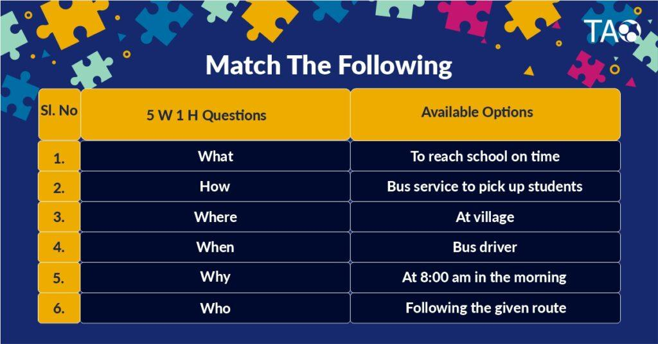
3.0 – Lesson 3 : The Standardize Cycle
Think & Fill Activity
Self Notes: Module 5- Test

Slide 110
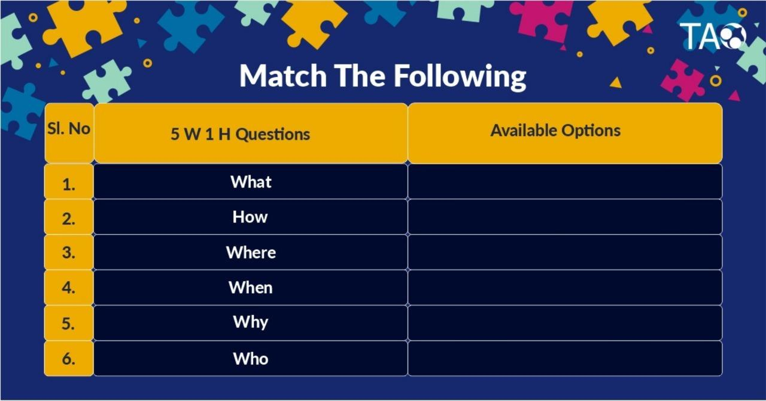
3.0 – Lesson 3 : The Standardize Cycle
Think & Fill Activity
Self Notes: Module 5- Test

Slide 111
Assessment
Write your Understandings and Learnings.
Self Notes: Module 5- Test

Slide 112
Reflection & Review
Great Work.. Add your quick reflections and module review and now you move to the Prototype Module
Self Notes: Module 5- Test

Slide 113
Conclusion
Write your Understandings and Learnings.
Self Notes: Module 5- Test

Slide 114
Thank You
Self Notes: Module 5- Test

